Slide 1

Time-use Activity-Pattern Recognition

Slide 2
Agenda
Introduction
Research Aim and Scope
Travel Pattern Analysis
What is TUS?
Data Description (UKTUS 2014-2015)
Data Preprocessing
Exploratory Data Analysis
Methods – PCA & K-means Clustering
Conclusion
QnA

Slide 3
Introduction
What is Travel Demand Model ?
Travel demand models use current travel behavior to predict future travel patterns from a sample of travel behavior data.
How does a travel demand model work ?
Trip generation (the number of trips to be made);
Trip distribution (where those trips go);
Mode choice (how the trips will be divided among the available modes of travel);
Trip assignment (predicting the route trips will take).

Slide 4
Research Aim and Scope
This study is primarily focused on the data processing required to extract activity patterns.
Extracting travel patterns and providing data for traffic planning applications using PCA and K means clustering approach.

Slide 5
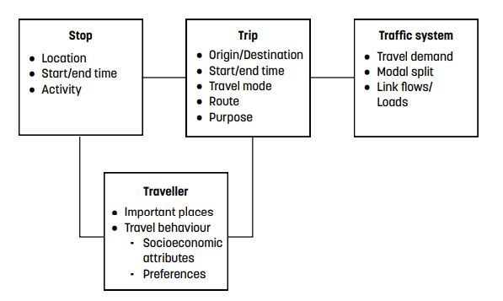
travel pattern analysis
The purpose of travel pattern analysis is to gain insight about aggregated travel patterns in the present, past, and future.

Slide 6
What is TUS ?
Time use refers to the subjective allocation of time to various activities and events.
Time usage data analysis, therefore, gives useful indications of people’s financial and behavioral situations.
The impact of these decisions on time use has substantial policy consequences for employment, social welfare, childcare, the labor market, healthcare, and education.
The UK Time Use Survey 2014-15 is an examination of how individuals in the United Kingdom spend their time.

Slide 7
TUS concepts and definitions
Time-use typology:
Necessary time
Contracted time
Committed time
Free time
Activities and episode:
Time usage as a sequence of actions.
In time, we may divide time into activities, which can be further divided into episodes.

Slide 8
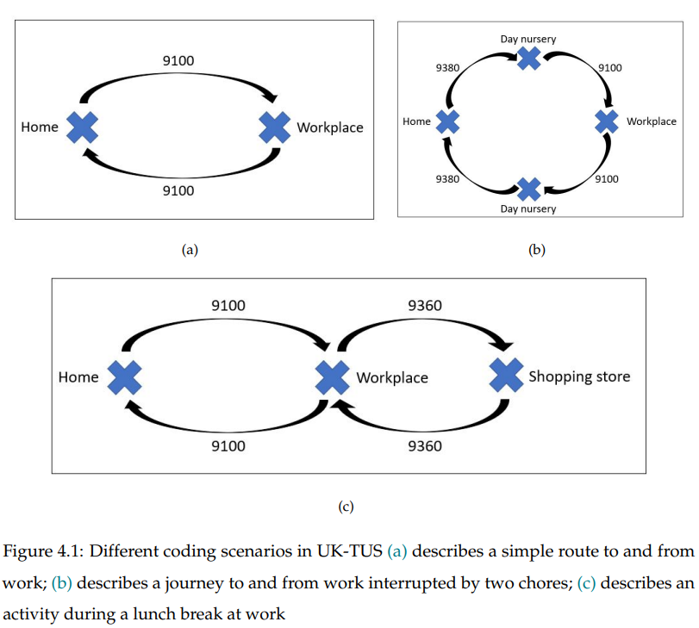
TUS concepts and definitions (Continued..)
Location, travel purpose and transport mode:
Time use survey locations itself represents the travel purpose.
Basic transport modes are given as car, bike or train.
Defining and coding journeys

Slide 9
Data Description (UKTUS 2014-2015)
The 2014-2015 Time Use Survey (UK-TUS) tracks how people aged 8 and above utilize their time.
The survey’s time-use diary asks respondents to record their daily activities.
6 Different formats of time diaries
Total of 11,860 households → 4,238 household interviews & 9,388 individuals' interviews.
Weekday data = 73% & Weekend data = 27%.

Slide 10
Data Preprocessing
Identifying and eliminating data for non-working days from the UK time usage survey data.
cleaning the dataset of any missing values,
The 24 hours were divided into 144 ten-minute sections.
In-home activities → Household chores, Home leisure, Night sleep
Out-of home activities → Workplace, School/college/Univeristy, Sport, Organizational/hobbies/Volunteer, Entertainment, Shopping and other services,

Slide 11
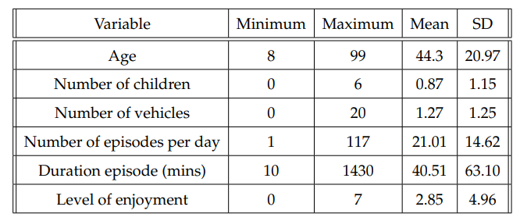
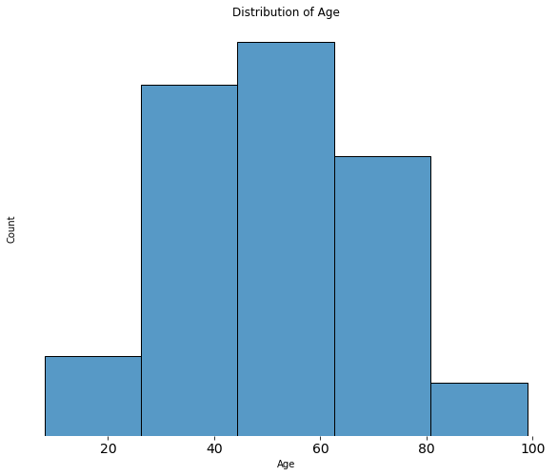
Exploratory Data Analysis
The average respondent was 44.3 years old (age range 8 to 99).
Individuals had 1.27 vehicles on average.
Enjoyment level was recorded on average at 2.85 (ranging from 0-7).

Slide 12
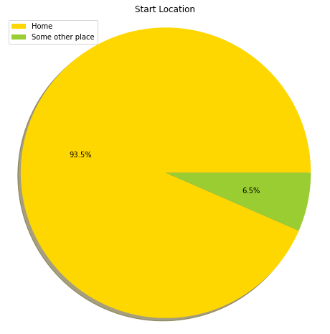
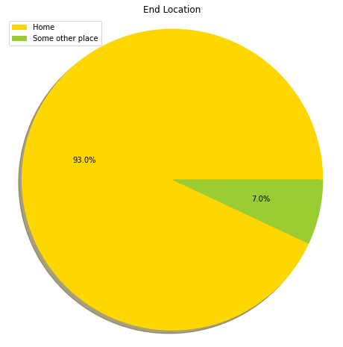
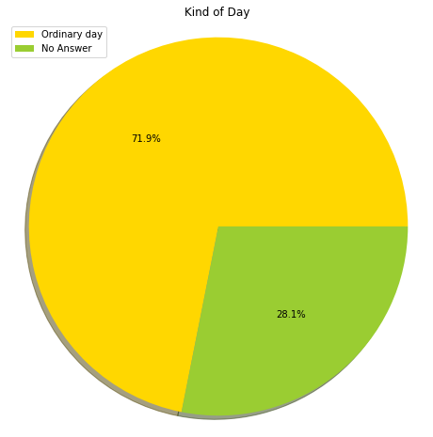
Exploratory Data Analysis (continued..) Start and End Location along with kind of day

Slide 13
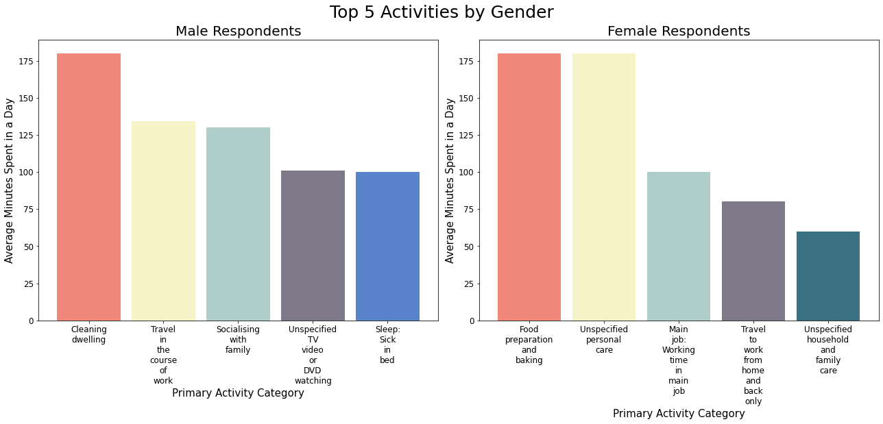
Exploratory Data Analysis (continued..) Top Primary and Secondary Activities by Gender

Slide 14
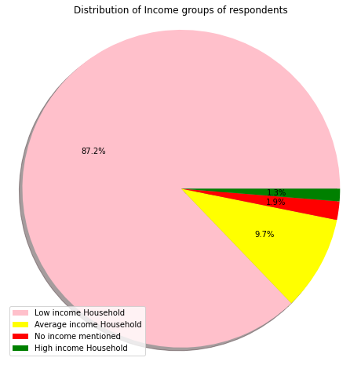
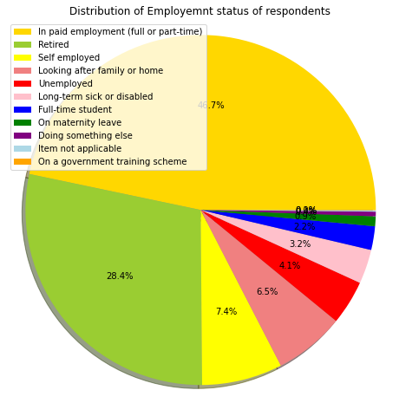
Exploratory Data Analysis (continued..) Employment status and income group distribution

Slide 15
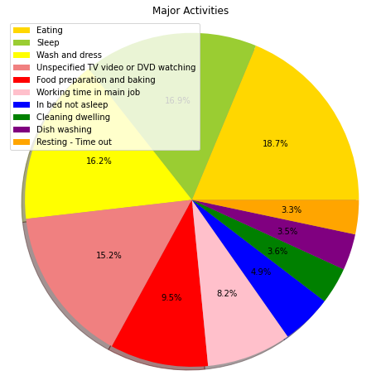
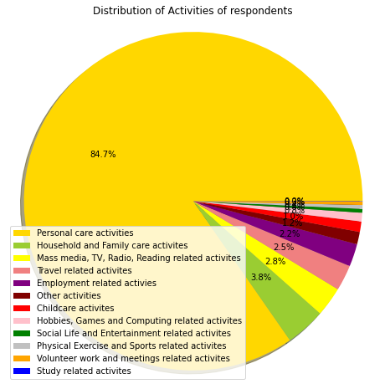
Exploratory Data Analysis (continued..) Activities Distribution

Slide 16
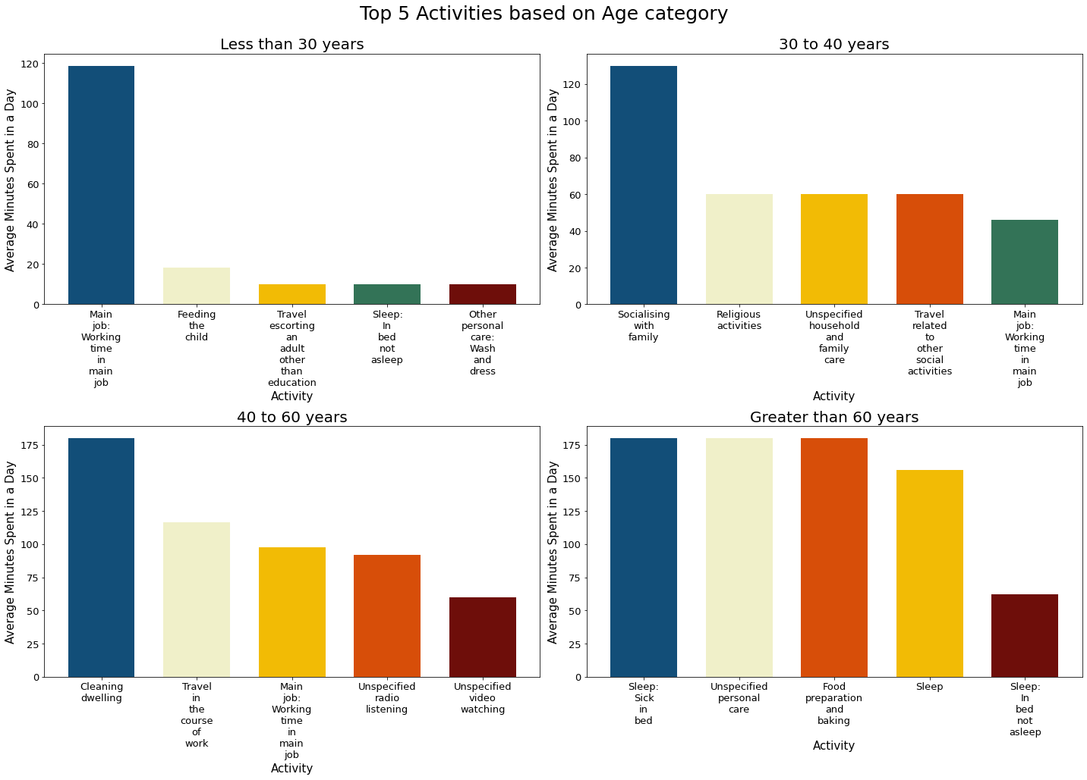
Exploratory Data Analysis (continued..) Primary and Secondary Activities based on Age groups

Slide 17
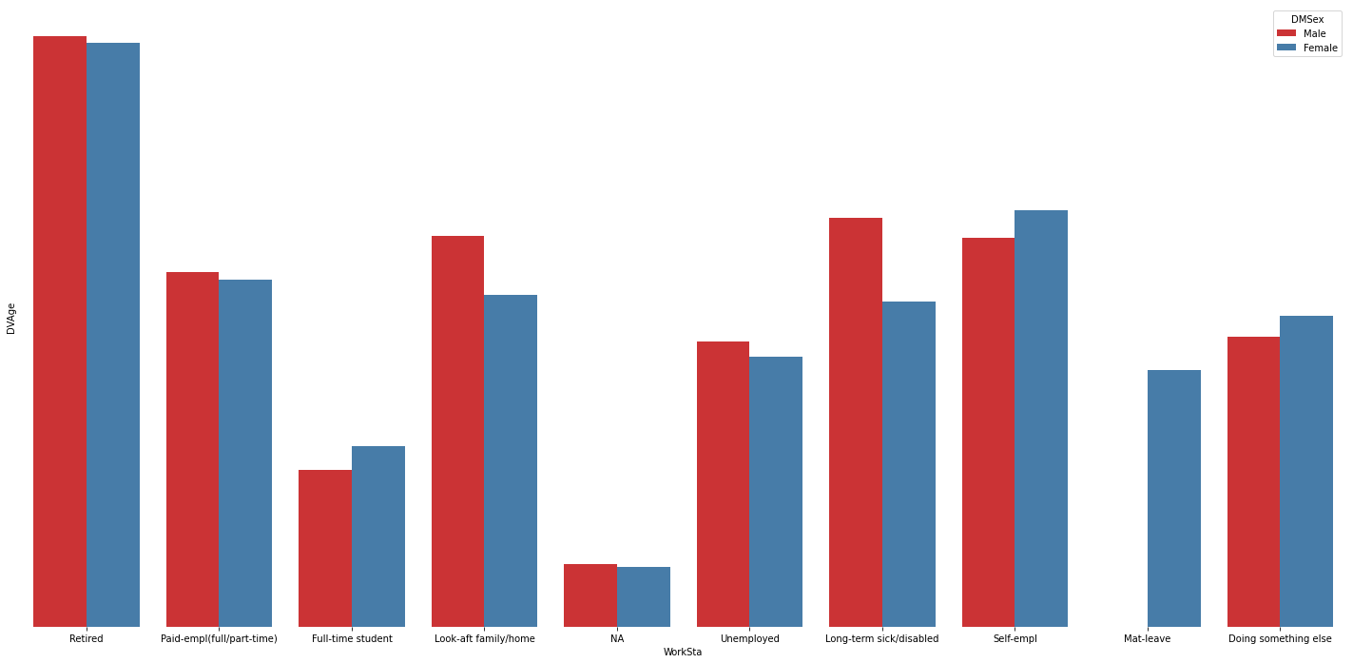
Exploratory Data Analysis (continued..) work status wrt gender

Slide 18
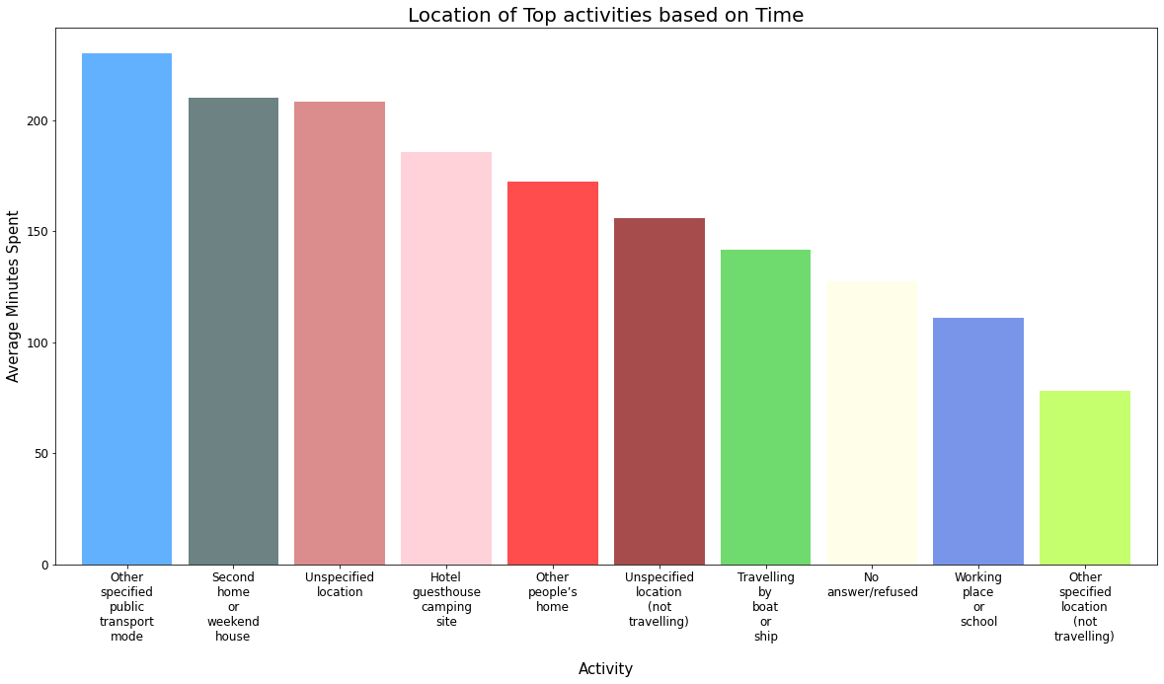
Exploratory Data Analysis (continued..) Location of Activities based on time

Slide 19
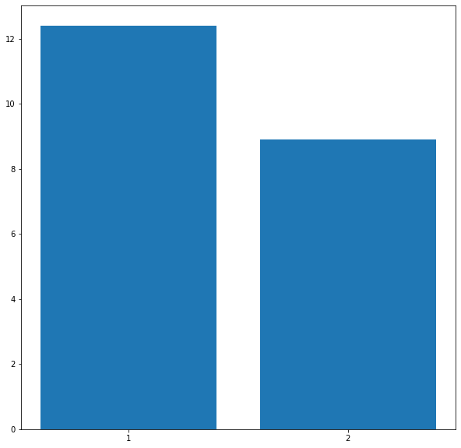
Principal Component Analysis
A technique for reducing the number of dimensions in a dataset while maintaining most of the information.
The number of primary components is less than the number of variables in the initial dataset.
Variance levels of principal components 1 and 2.

Slide 20
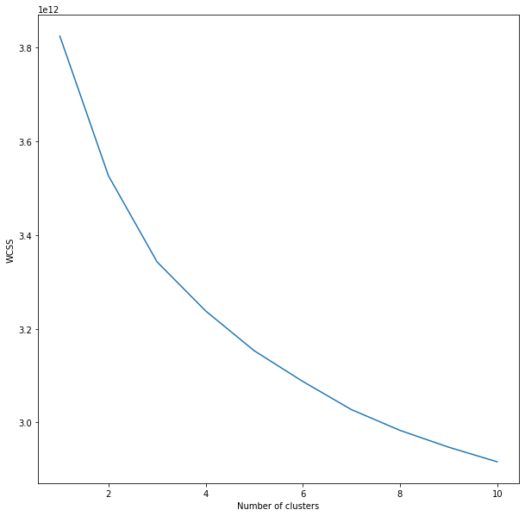
WCSS
WCSS is the sum of the squared distances between each point in a cluster and its centroid.
When we examine the graph, we can observe that it rapidly changes at a spot, resulting in an elbow form.
The graph begins to travel practically parallel to the X-axis at this point. This point’s K value corresponds to the ideal K value, or the optimal number of clusters.
When we plot the WCSS with the K value, we get an Elbow.

Slide 21
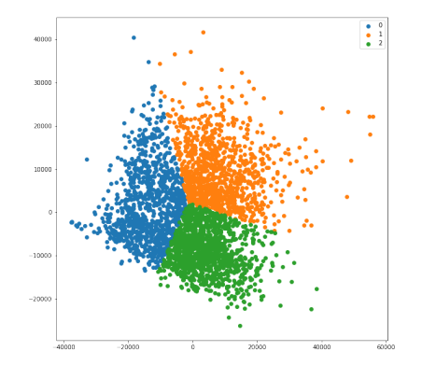

K-means Clustering
The fundamental goal of K-means Clustering is to group n observations into k clusters.
Euclidean distance:
Clustering of similar activities

Slide 22
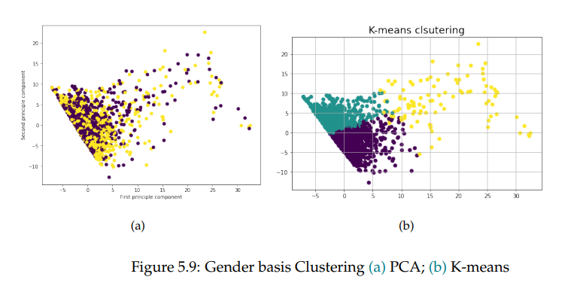
K-means Clustering (continued..)

Slide 23
Conclusion
TUS give complete reports of daily activities primary, secondary, tertiary, combined and alone as well as measures of enjoyment throughout the day at various points in the journey.
Using data from the extensive UK time use diary survey, for a household activity survey, we modelled the 48 hrs in-home and out-of-home time-use activity patterns of individuals drawn from the UK-time use diary survey.
We checked for the Enjoyment level, Age, Income and many more features for individuals through this survey data.
We demonstrated in this work how cluster analysis might be utilised to discover variations in sociodemographic features between population groups with varying daily activity patterns.
By utilizing publicly accessible travel survey data and K-means clustering via PCA methodologies, this work elucidates the regular patterns of everyday human activities.
Research on land use and activity patterns may help manage congestion and improve models that predict human movement.

Slide 24

Thank you !!
Any questions ???

